Slide 1

Dynamic Network Prioritization Using SDN
Team: Game Of Networks
Team Members:
Zaid Laffta (009689433)
Karan Ghorpade (013720096)
Riya Chaugule (013769262)
Sreeparvathi Nambiar (013761735)

Slide 2
Agenda
Introduction
Motivation
Lab Execution
Problems Faced
Future Improvements
Q&A

Slide 3
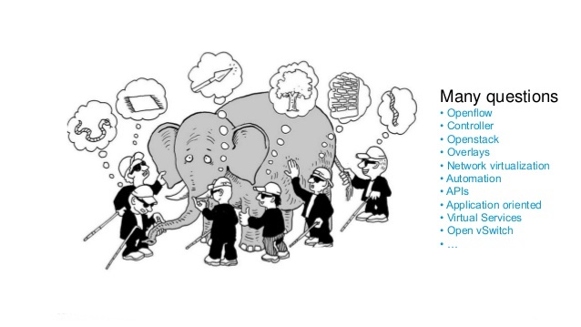

Slide 4
Introduction
What is SDN: Software Defined Networking
Control & Data Planes separation where you will use OpenFlow to control white box switches
Broader Definition: Feed information from the application layer to the network

Slide 5
SDN OVERVIEW

Slide 6
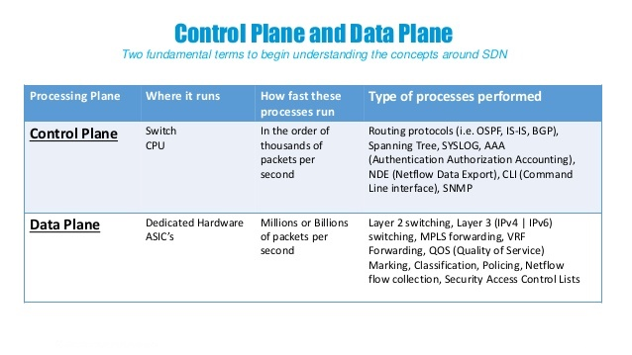

Slide 7
Network Programmability
Add static configuration?
Interact with operational data and state information
Reduce man hours
Reduce human errors
Customization
Smart Network!

Slide 8
Motivation
Cost to deploy and maintain the network is more than the cost of the equipment
Using CLI for configuration by using pre-written and test scripts
Eliminate pilot errors
Explore concept we study like OpenFlow, SDN, and Open vSwitch
Logically centralized intelligence and control
Dynamically examining traffic flowing
Enabling individual applications to directly program the network to acquired the resources they need to optimize performance

Slide 9
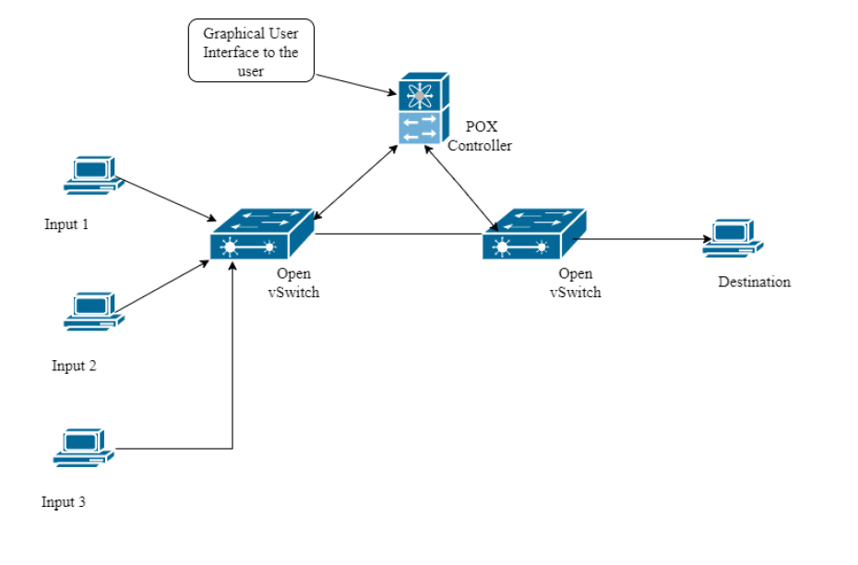
Topology
Script repository
the brain of our
implementation

Slide 10
Lab Execution
Enterprise grade equipment, lost case
You will need an Open vSwitch
Any number of switches

Slide 11
Workflow
The QoS Value and the priority are obtained from the user and pushed to the POX controller
When there is a flow of packet from source to switch, the switch first checks in the flow table for the forwarding entry
If the switch does not have the forwarding information, it sends an openflow message (Packet-In) to the controller requesting for the forwarding information
The controller does DPI and extracts the QoS/ToS value from the packets, passes it to the source file and gets the priority based on the QoS mapping in the source file. Then based on the received priority controller will construct a flow table entry which says the switch to move the packets to different queues
Controller then sends the open flow messages with this queue information to the OvS. OvS then forwards the input packets from ingress ports to differently prioritized queues in the egress ports.

Slide 12
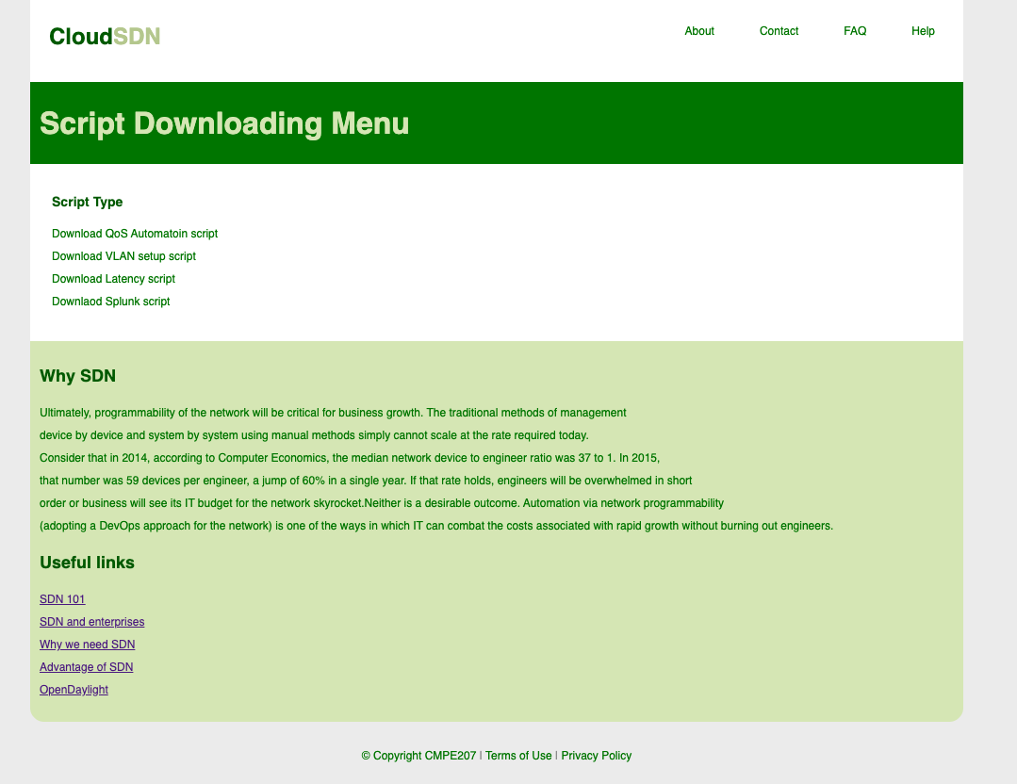
GUI

Slide 13
Quick Demo of GUI
file:///Users/zaid.laffta/Desktop/project207/Untitled.html

Slide 14
Project Execution Video
Live Demo!!!

Slide 15
Problem Faced
Equipment: white box switches are expansive. We used Mininet
Enterprise switches will not work
Big Network will have some latency
Mininet keep crashing

Slide 16
Conclusion
-SDN promises to transform today’s static networks into flexible, scalable, programmable platforms with the intelligence to allocate resources dynamically
- With all advantages stated, SDN is on the way to become the new approach for networking

Slide 17
Future scope
GUI base controller with different libraries of scripts
Customizable scripts like application based or time based
Smart controller!!!!

Slide 18

Thanks you!

